Slide 1

Candy Crush Simulation
朱信靂・彭偉倫・李哲安

Slide 2
Abstract
In Candy Crush, players complete levels by achieving goals of that level, such as collecting candies or removing all jellies.
To achieve the goal, players can eliminate candies by swapping them to make a match of the same color.

Slide 3
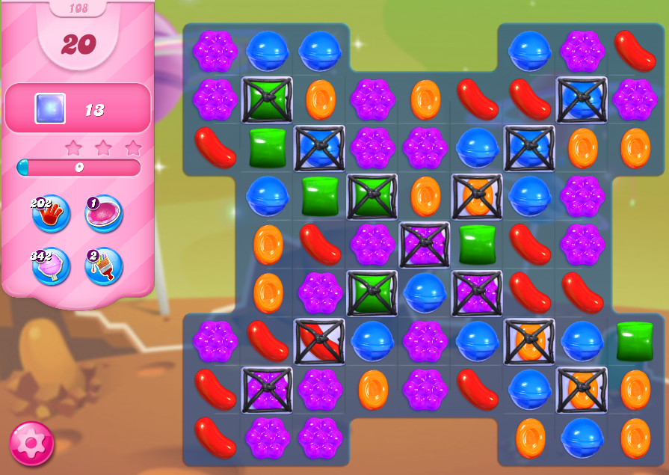
Gameplay Example
Moves left
Goal
# of jellies left
There are 6 ways of swapping candies.

Slide 4
Problem
To raise the probability of passing levels, one should make decisions in the game based on some strategy.
However, it is hard to find a specific strategy due to high uncertainty and unpredictability.

Slide 5
Mathematical Analysis
We use a simplified model.
There are only 2 kinds of candies in a 3× 3 board.

Slide 6


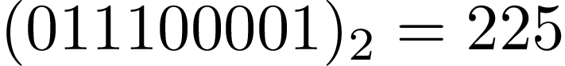
Mathematical Analysis
Given a status, we can turn it into a nonnegative integer by binary representation.
0 | 1 | 1
1 | 0 | 0
0 | 0 | 1

Slide 7
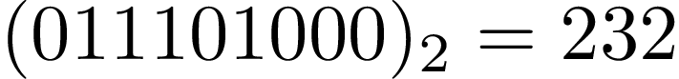
Mathematical Analysis
If a move allows eliminations occur, then it causes the change of states.
0 | 1 | 1
1 | 0 | 1
0 | 0 | 0

Slide 8
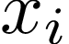
29
93
157
221
232
285
349
413
477
Let be the expected value of number of candies eliminated starting from the state of index .

Slide 9
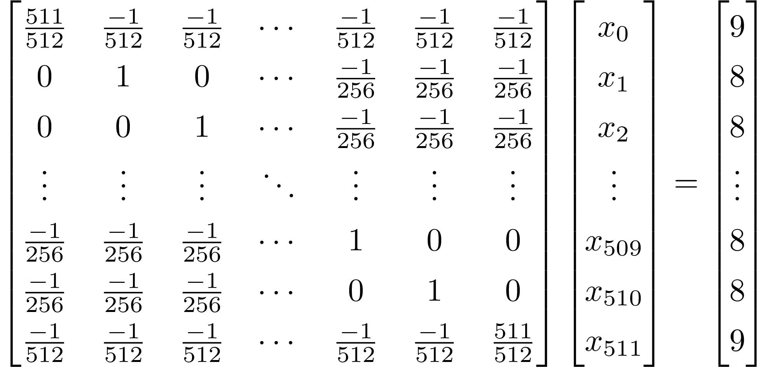
By enumerating the 512 equations, we can build up a matrix equation and then solve it to find out the exact expected values.

Slide 10
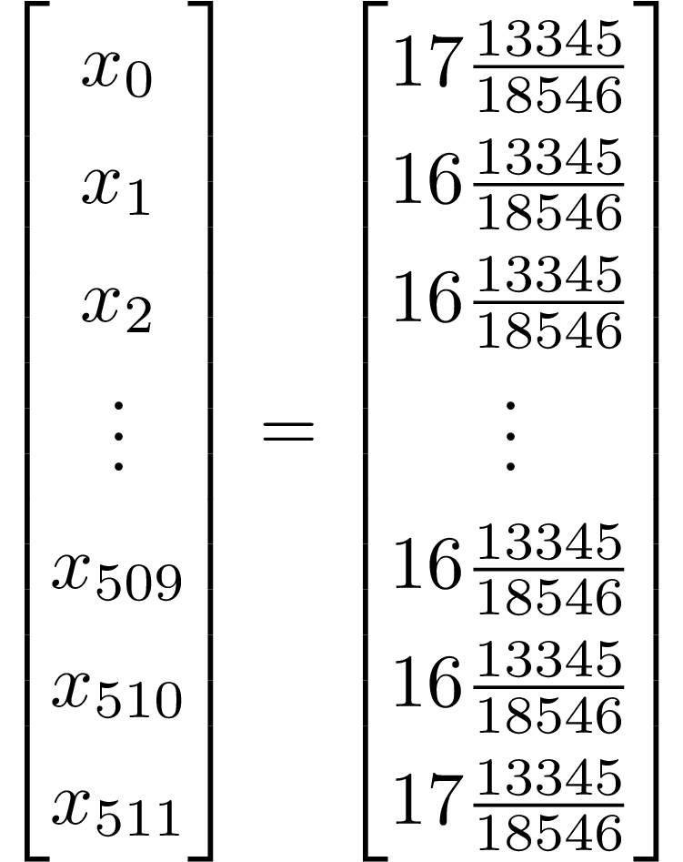
By enumerating the 512 equations, we can build up a matrix equation and then solve it to find out the exact expected values.

Slide 11
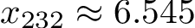
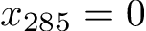
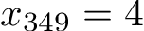
Mathematical Analysis
Thus, the calculation of the theoretical expected value of each status has completed.

Slide 12
Comparison
Based on the calculation, we want to find out whether it is better if we know the expected value of each status.
We want the compare 2 strategies on a 3×3 board (with 2 kinds of candies):
Strategy 1: Random Move
Strategy 2: Choose the Best Expected Value

Slide 13
Comparison
(Candies)
Choose the Highest Expected Value
Random Move
(Moves)

Slide 14
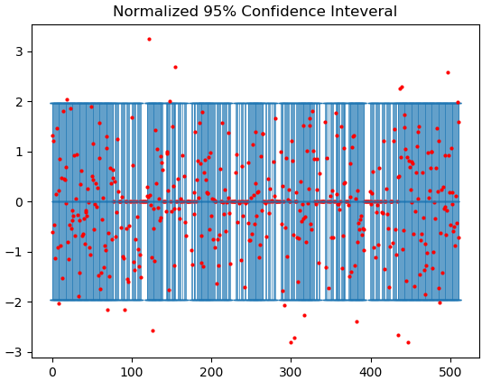
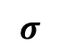
Comparison
$$σ$$
N = 1000
98.4% true mean is in the confidence interval
board

Slide 15
Analysis : row
We want to know eliminate which row has the highest expected value
?
?

Slide 16
Analysis : row
Matrix of row elimination expected value
4.9863 | 5.7324 | 5.9561 | 5.9827 | 6.0894 | 5.7053 | 4.9294
6.9637 | 8.0382 | 8.8359 | 8.967 | 8.8137 | 8.0469 | 7.0762
9.4146 | 11.209 | 12.736 | 12.5607 | 12.8001 | 11.1439 | 9.5001
10.7859 | 13.073 | 14.9296 | 14.8566 | 14.9679 | 12.7831 | 10.8206
12.4611 | 15.0237 | 17.3426 | 17.8604 | 17.4106 | 15.0199 | 12.3889
13.7816 | 17.3276 | 19.8177 | 20.0506 | 20.0775 | 16.8964 | 13.7349
15.8965 | 19.4891 | 22.7096 | 23.7245 | 22.6479 | 19.4844 | 15.7679
15.1634 | 19.2124 | 22.5113 | 22.8318 | 22.5092 | 19.0143 | 15.2546
14.7247 | 18.3993 | 22.4808 | 22.7004 | 22.23 | 18.257 | 14.4622
* Number: How many candies expected to be eliminated

Slide 17
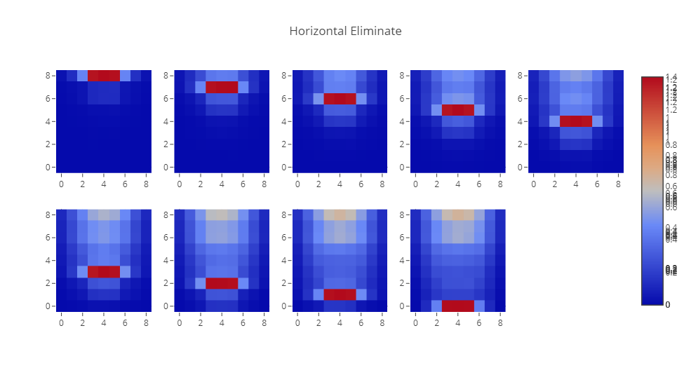
Analysis : row
The influence of row elimination
1.4
0
* Number: How many candies expected to be eliminated in specific location

Slide 18
Analysis : column
Eliminate which column has the hightest expected value
?
?

Slide 19
Analysis : column
Matrix of column elimination expected value
5.1248 | 6.7924 | 8.2864 | 8.545 | 8.6711 | 8.4651 | 8.36 | 6.8289 | 5.208
6.2436 | 8.8095 | 10.9702 | 11.4479 | 11.7547 | 11.3786 | 10.8517 | 8.8471 | 6.32
6.9625 | 10.5848 | 13.3913 | 13.5871 | 14.2746 | 13.6066 | 13.0762 | 10.570 | 7.0517
7.5273 | 11.6672 | 15.3584 | 15.8649 | 16.5761 | 15.8018 | 15.3131 | 11.7751 | 7.5614
8.055 | 12.9858 | 17.1862 | 18.0035 | 19.004 | 18.1837 | 17.2231 | 12.9321 | 8.0694
8.315 | 14.0418 | 18.2196 | 19.4294 | 20.6887 | 19.5465 | 18.5501 | 13.7243 | 8.2802
8.0644 | 13.9568 | 18.8757 | 19.8582 | 21.3133 | 19.8533 | 18.9409 | 14.2871 | 8.2846
* Number: How many candies expected to be eliminated

Slide 20
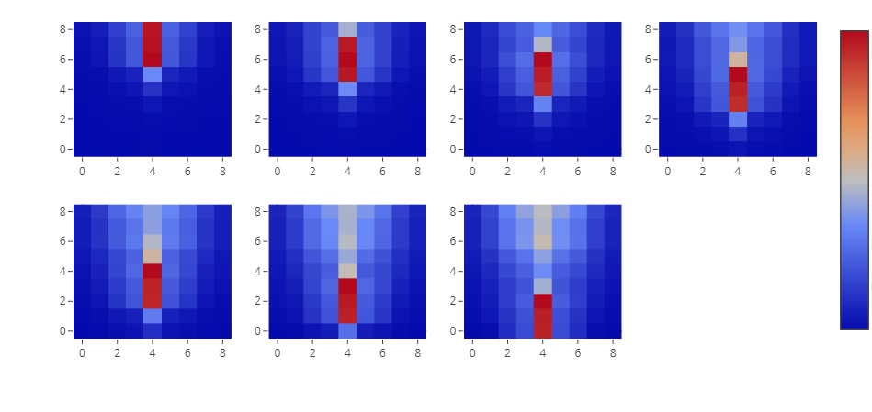
Analysis : column
The influence of column eliminating
1.4
0
* Number: How many candies expected to be eliminated in specific location

Slide 21
Analysis
Result 1: eliminate rows has higher expected value
the max expected value of columns: 21.3133
the max expected value of rows: 23.7245
Result 2: the best expected value of row is not at the bottom ,while the best stategy of column is at the bottom.

Slide 22
Analysis : strategy
Strategy 1: random elimination
Strategy 2: priority of horizontal elimination
Strategy 3: priority of vertical elimination
Strategy 4: priority of horizontal & deeper elimination
Strategy 5: priority of vertical & deeper elimination

Slide 23
After 50 steps
priority of horizontal & deeper elimination
priority of vertical & deeper elimination
priority of horizontal elimination
random elimination
priority of vertical elimination

Slide 24
Conclusion
Horizontal elimination has higher expected value than vertical one.
Strategies of deeper elimination has higher expected value than the random one.
the best expected value of row is not at the bottom ,while the best stategy of column is at the bottom.

Slide 25

Thanks for listening

